Slide 1
GRAPH SHORTEST PATH ALGORITHM
PRESENTED BY:
MBENG FRANCIS NJUA
MEGNE SANDIE MAYIVA
BALEMBA JOS BRIAN

Slide 2
DEFINITION
Graph shortest path algorithm is an algorithm which Is used for finding the shortest paths between nodes in a weighted graph, it can be used for example to represent road networks.

Slide 3
TYPES OF SHORTEST PATH ALGORITHMS
The are four types of shortest path algorithms:
DIJKSTRA’S ALGORITHM
BELLMAN-FORD ALGORITHM
FLOYD-WARSHALL ALGORITHM
A* ALGORITHM

Slide 4
Advantages of shortest path algorithm
EFFICIENNCY: The shortest path algorithm, such as the Dijkstra’s algorithm , are efficient in finding shortest path between nodes in a graph, even in large and complex networks.
ACCURACY: This algorithms provide an accurate and optimal solution to finding the shortest path, which is crucial in various real-world applications such as navigation systems and logistics.
VERSATILITY: This shortest path algorithms can be applied to a wide range of problems, including; network routing, transportation planning, and resource allocation.

Slide 5
Disadvantages of shortest path algorithm
COMPLEXITY: Some graph shortest path algorithm can be complex to implement and require a deep understanding of graphs theory and data structures.
LIMITED APPLICABILITY: These algorithms are versatile they may not be suitable for all types of graphs or network structures, especially in the cases where the graph is constantly changing.
RESOURCE CONSUMPTION: Depending on the size and complexity of the graph, these algorithms can consumes a significant amount of computational resources, which may not be feasible in certain applications.

Slide 6
DIJKSTRA’S ALGORITHM
Dijkstra’s algorithm is used to find the shortest path between the two mentioned vertices of a graph by applying the Greedy Algorithm as the basis of principle.

Slide 7
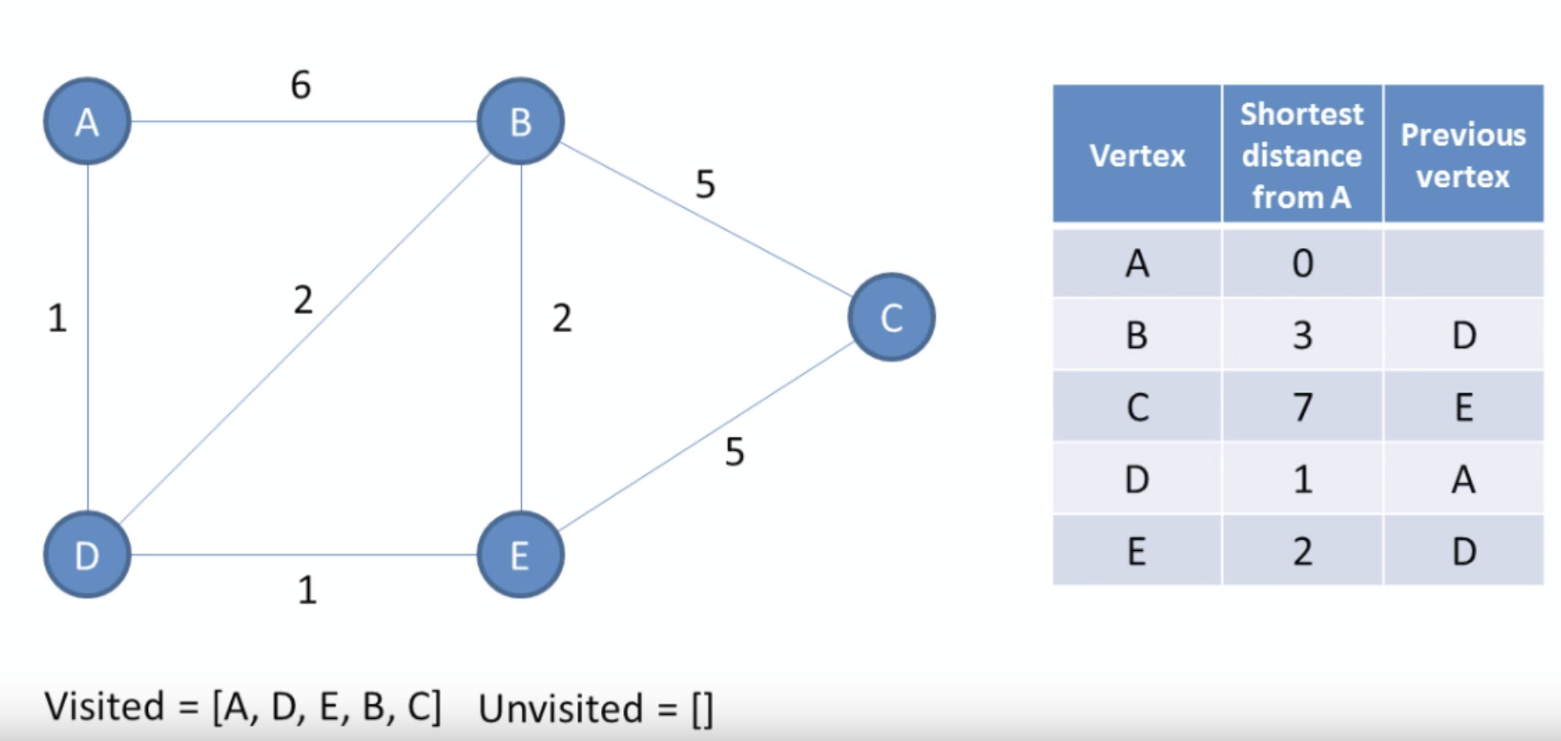
Implementing Dijkstra’s Algorithm

Slide 8
BELLMAN-FORD ALGORITHM
Dynamic Programming is used in the Bellman-Ford algorithm. It begins with a starting vertex and calculates the distances between other vertices that a single edge can reach. It then searches for a path with two edges, and so on. The Bellman-Ford algorithm uses the bottom-up approach.

Slide 9
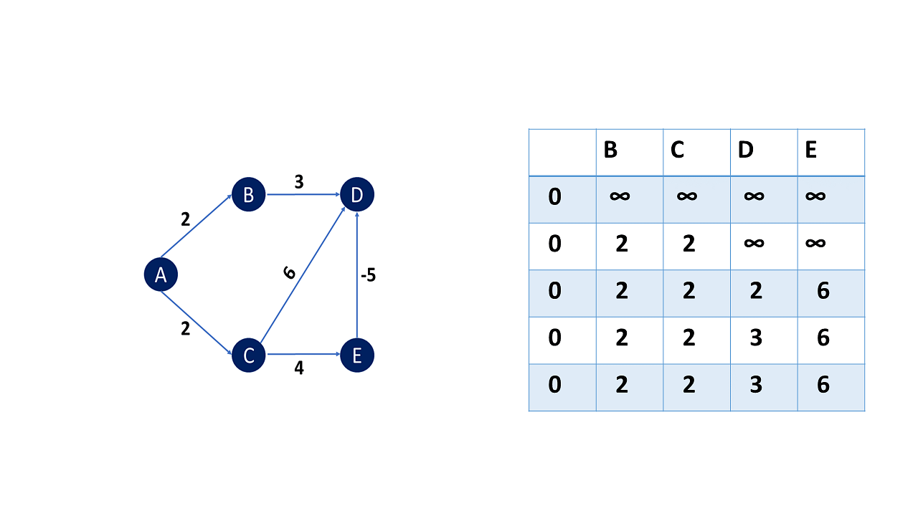

Slide 10
How Does the Bellman-Ford Algorithm Work?
Make a list of all the graph's edges. This is simple if an adjacency list represents the graph.
"V - 1" is used to calculate the number of iterations. Because the shortest distance to an edge can be adjusted V - 1 time at most, the number of iterations will increase the same number of vertices.
Begin with an arbitrary vertex and a minimum distance of zero. Because you are exaggerating the actual distances, all other nodes should be assigned infinity.
If the new distance is less than the previous one, update the distance for each Edge in each iteration. The distance to each node is the total distance from the starting node to this specific node.
To ensure that all possible paths are considered, you must consider alliterations. You will end up with the shortest distance if you do this.

Slide 11
Uses of Bellman-Ford Algorithm
Identifying negative weight cycles
In a chemical reaction, calculate the smallest possible heat gain/loss.
Identifying the most efficient currency conversion method.

Slide 12
Applications of the Bellman-Ford Algorithm
Examining a graph for the presence of negative weight cycles.
Using negative weights, find the shortest path in a graph.
Routing is a concept used in data networks.

Slide 13
FLOYD-WARSHALL ALGORITHM
The Floyd Warshall Algorithm is used to calculate the shortest path between two pairs of numbers. The goal is to discover the shortest distance between each pair of vertices in an edge-weighted directed Graph.

Slide 14
What Is the Solution to the All Pair Shortest Path Problem Using the Floyd Warshall Algorithm?
You use Dynamic programming to solve the problem using the Floyd Warshall algorithm,
You set the solution matrix to the same value as the input graph matrix.
The solution matrix is then updated by treating all vertices as an intermediate vertex.
The goal is to choose all vertices one by one and update all shortest routes that involve the picked vertex as an intermediate vertex.

Slide 15
